Slide 1
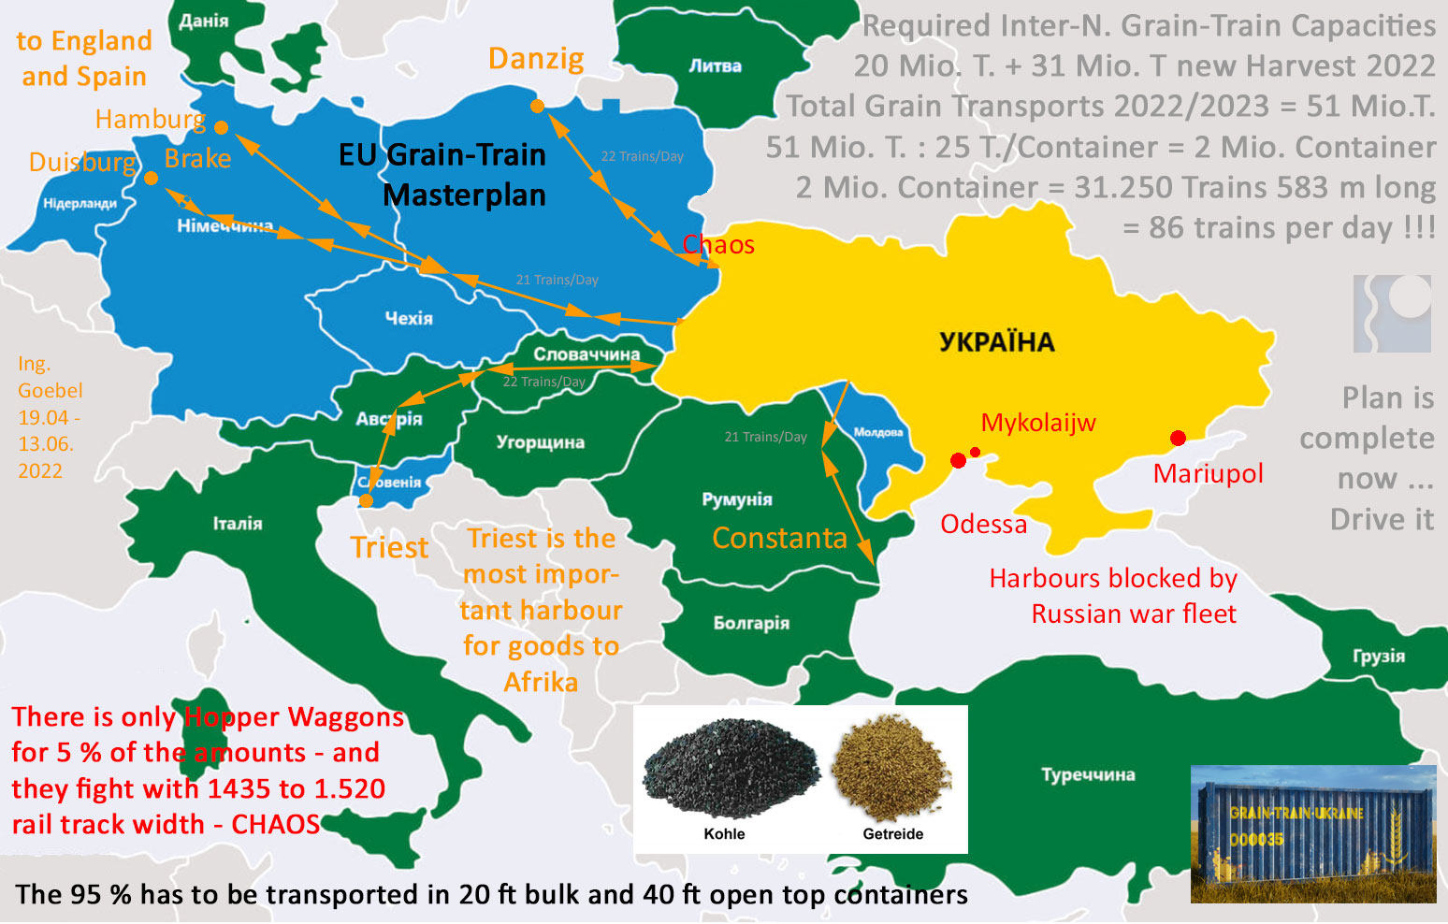
„Grain-Trains-Ukraine“
within
„EU Solidarity Lanes“
General Logistic Plan
Ing. Goebel DE and
Ing. Gorunenko UA

Slide 3
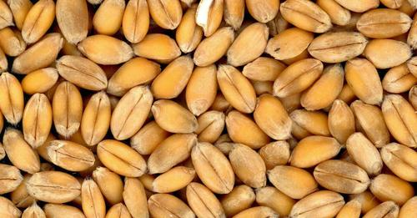
The 4 to 6 Country-Grain-Lanes within Grain-Trains-Ukraine Plan
>>> Train-Transport of Grain from Ukraine via Poland-Ukraine border-area to :
Danzig Harbour in Poland - (already working, but too long travel-time)
Hamburg Harbour in Germany via Poland
Bremen Harbour in Germany via Poland
Triest Harbour in Italy via Slovakia, Austria, Slovenia
Constanta Harbour in Romania - (already working ! but limited volume)
Muuga Harbour in Estonia via Poland, Lithuania, Latvia
>>> And back to Poland-Ukraine border area with Coal and Building Materials

Slide 4
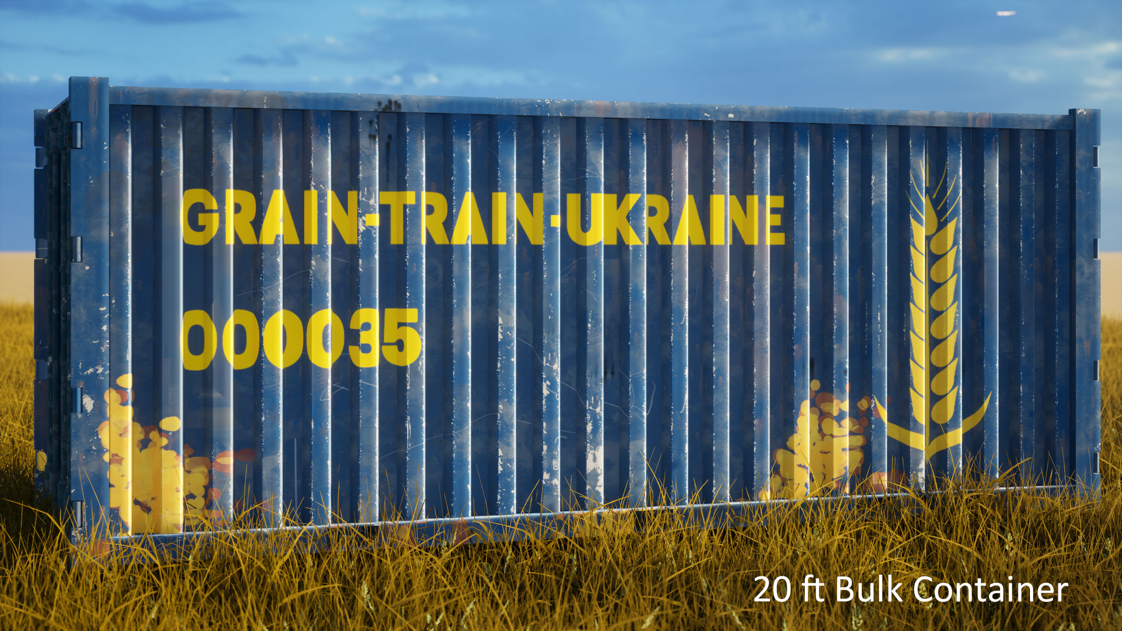
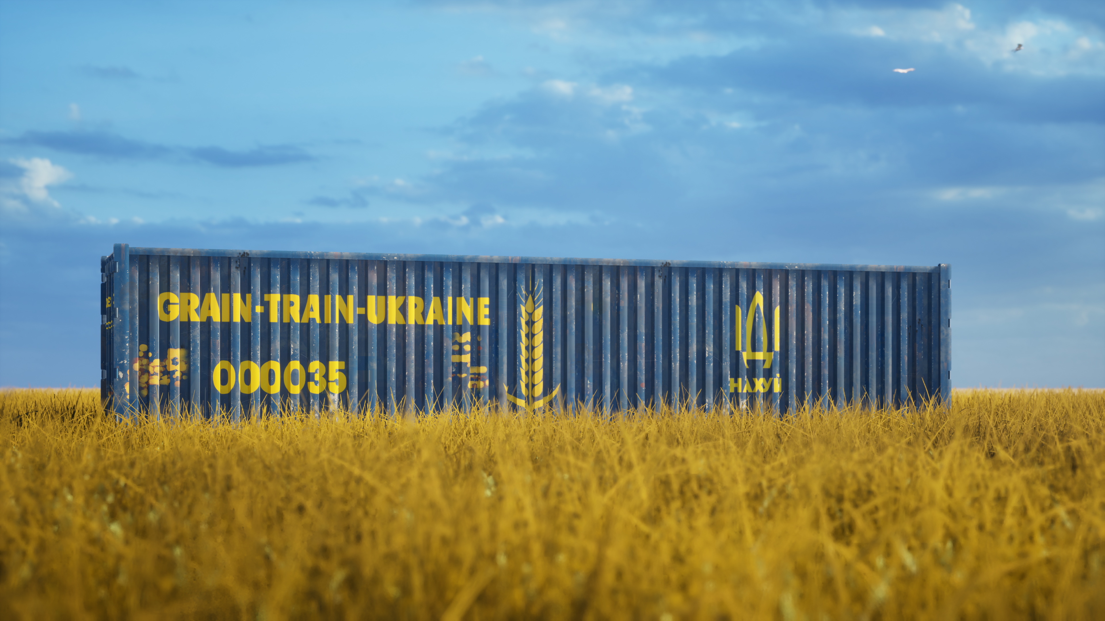
As there is NOT much free Grain-Hopper-Waggons in EU The transports have to take place in BULK CONTAINERS :
useful Container types
20 ft Bulk Container
40 ft Bulk Container
40 ft Open Top
Containers
with PVC or Hardtop
Containers mostly new

Slide 5
Deloading 1.520 Hoppers and Loading 1.435 Containers

Slide 6
Problems in re-locating a 51 Mio. tons Grain-Market from Odessa Harbour to other Harbours EU by land-transport :
- Railway-Companies in Poland and Germany are : „STIFF-MONOPOLISTS“
Unflexible, expensive. - It needs political pressure to make them work !
- EU does not want to pay 3 Mio. EUR for SUPRA-NATIONAL TASK buying
the Deloading-Loading equipment from Kongskilde Denmark - URGENT
- Agri-Companies, Grain-Traiders and Farmers are afraid to deal with these
unflexible EU Railway-Companies. no UA language, no service, high prices
- It needs changes, political pressure and Container invest for AMOUNTS

Slide 7
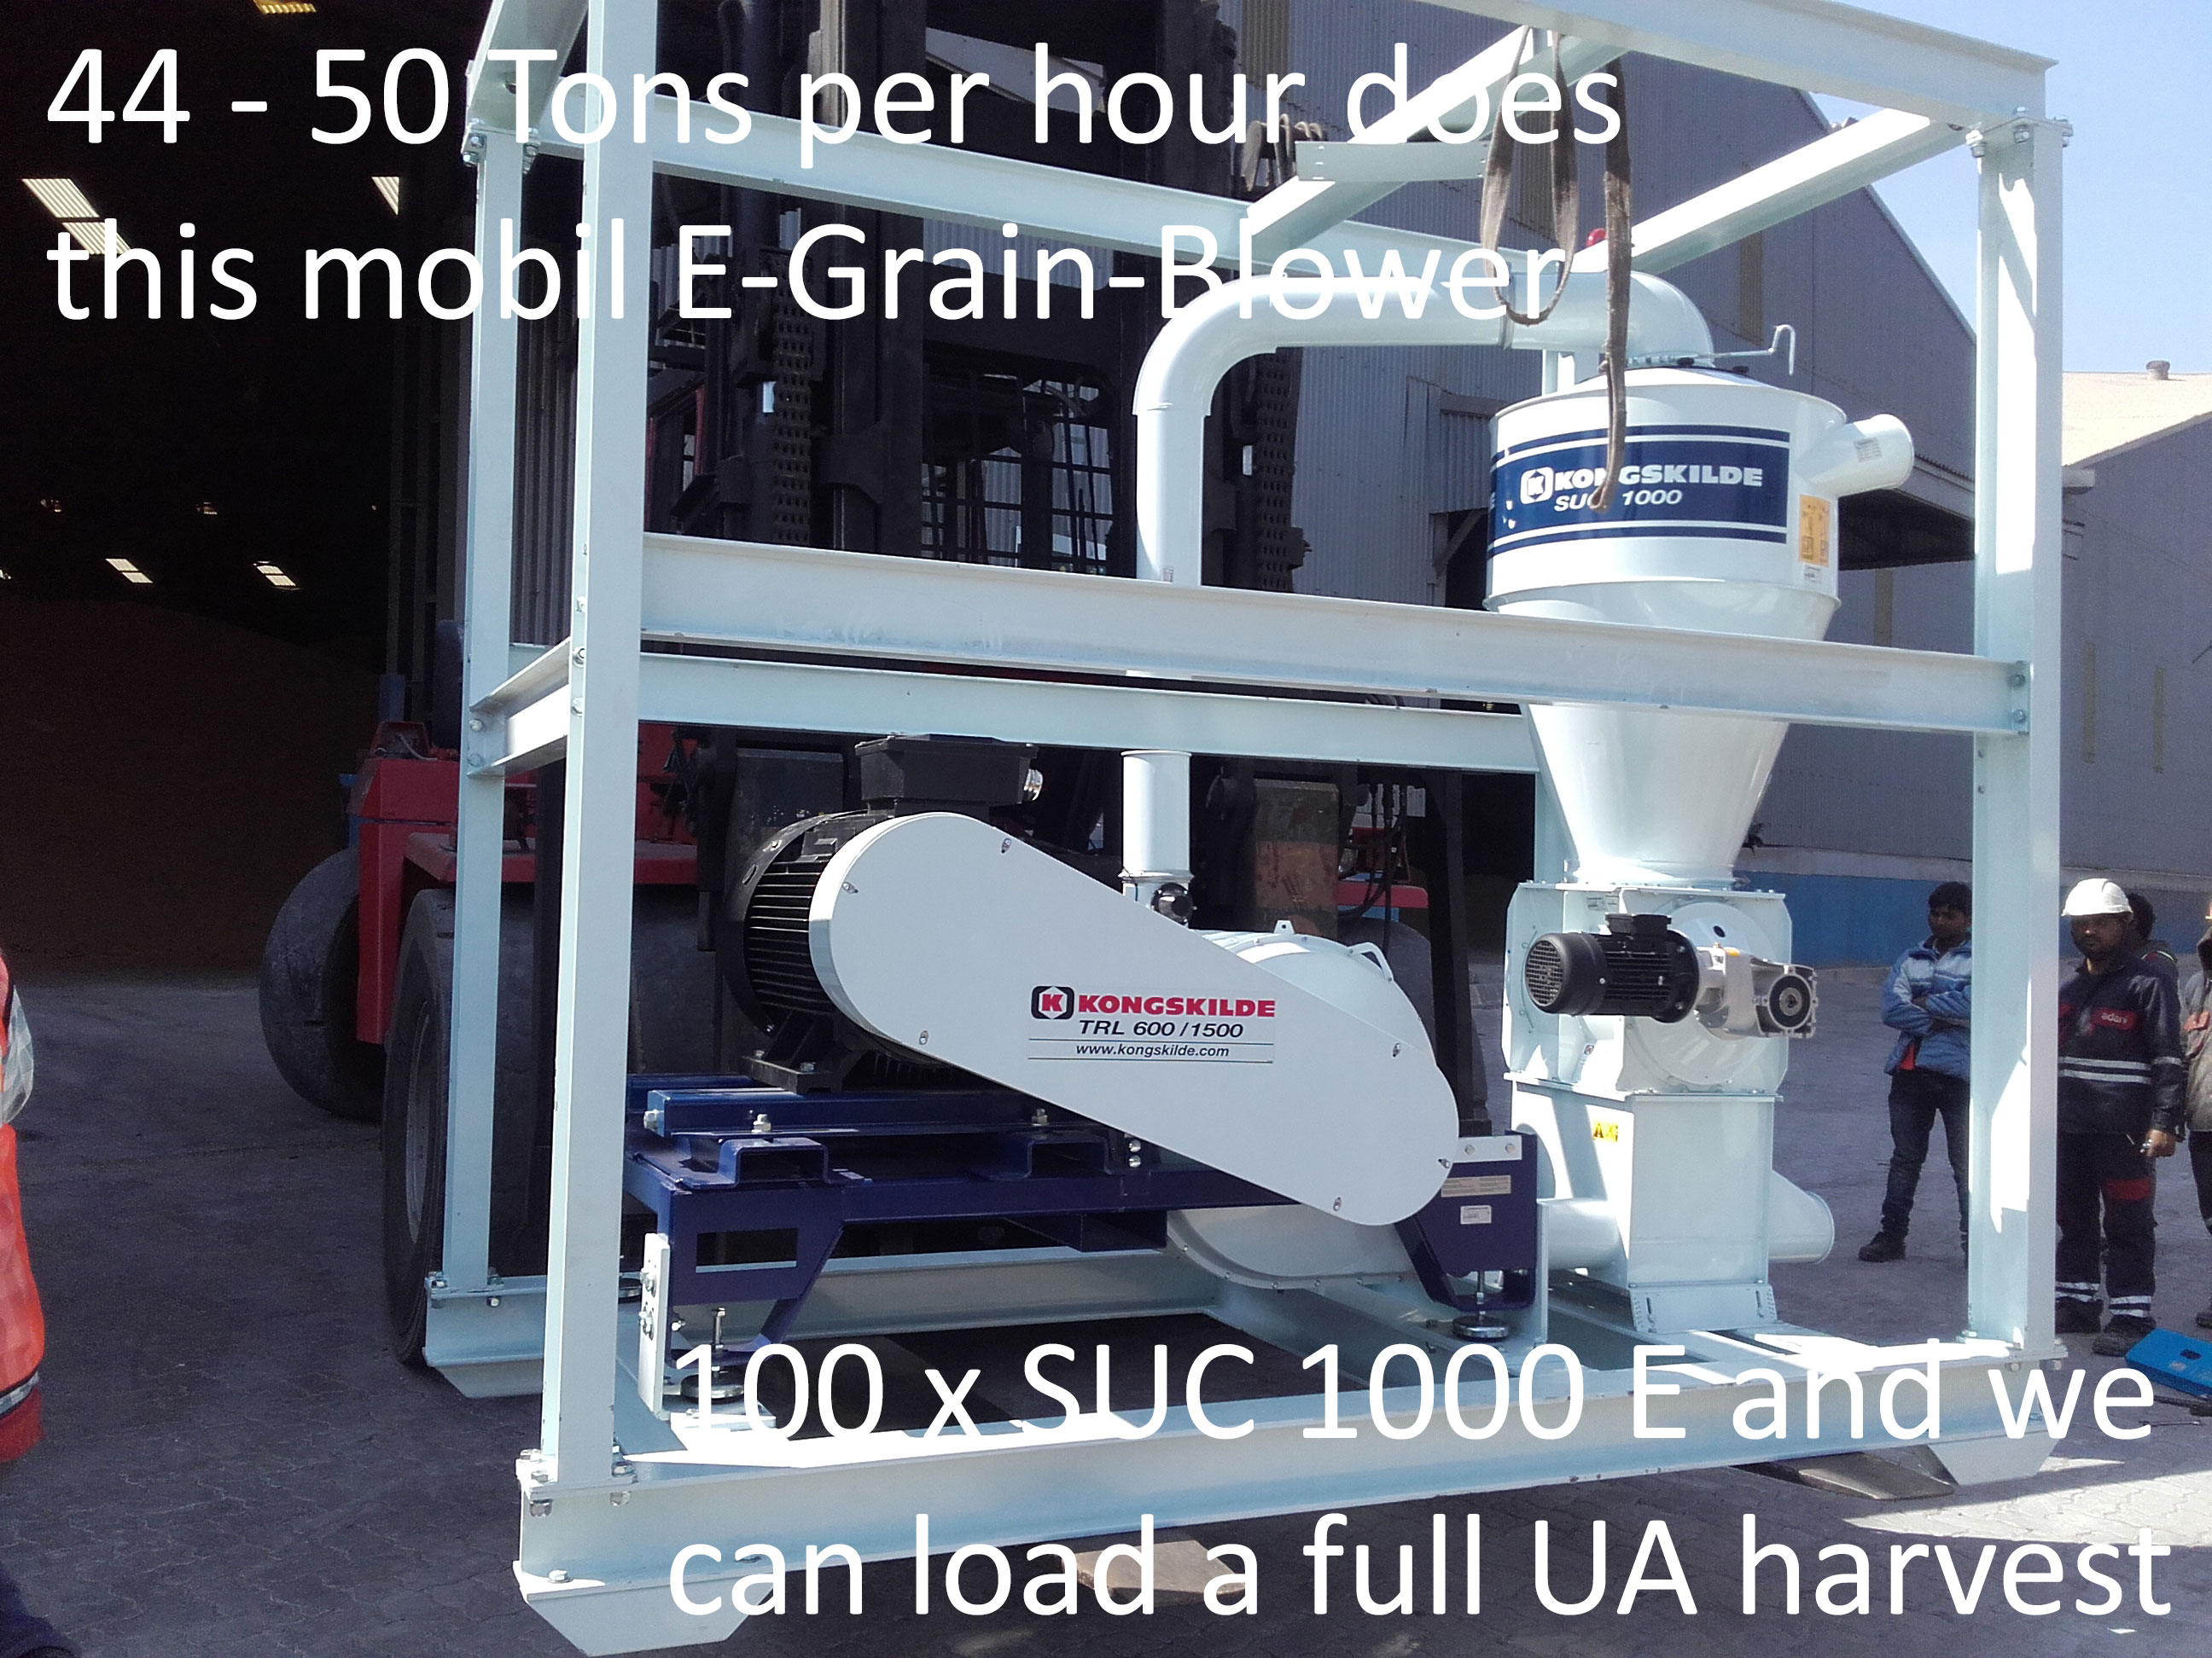
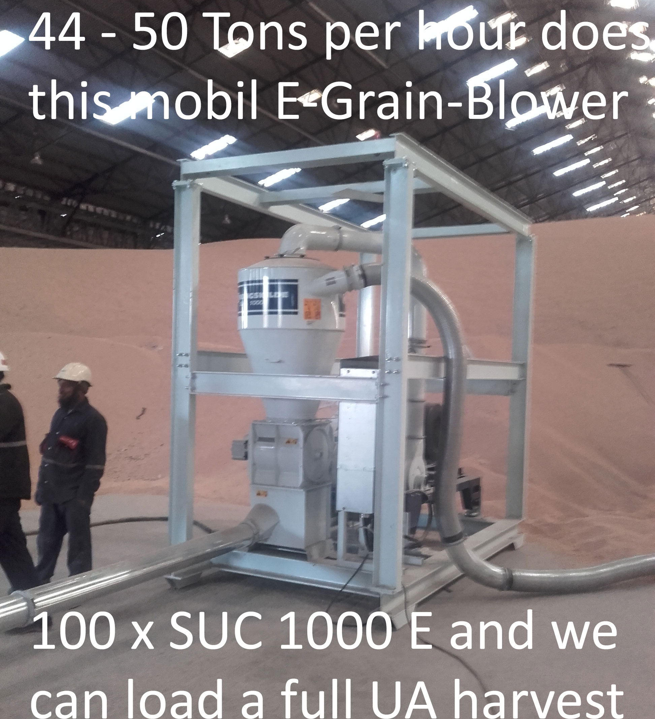
This is how the urgently required Grain-Conveyors look like

Slide 8
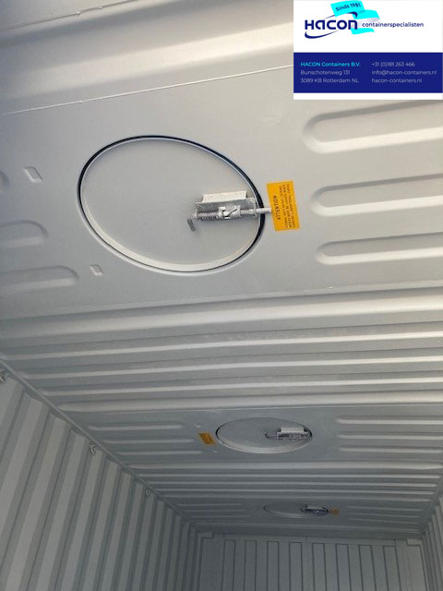
This is how BULK Containers look like : (3.000 – 5.000 €)

Slide 9
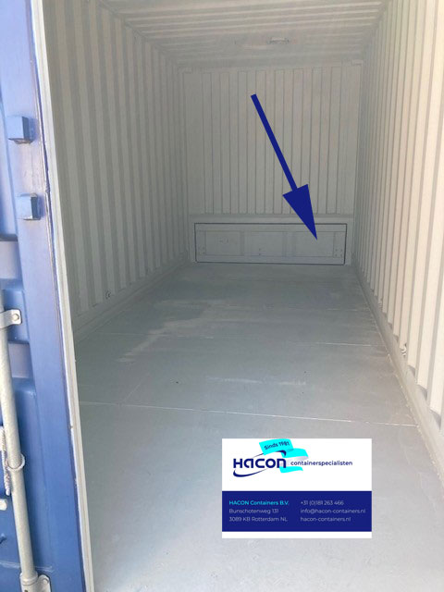
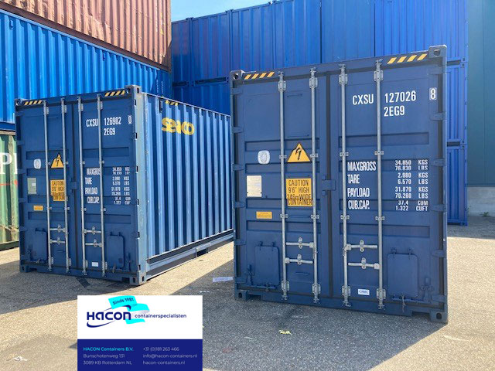
This is how BULK Containers look like : (3.000 – 5.000 €)

Slide 10
What makes the Grain-Trains-Ukraine Plan competitive :
Containers (4.000 EUR) can replace Grain-Hopper Waggons (170.000 EUR)
All Grain-Hoppers-Waggons in EU are already fully booked for EU harvest
We start De-Loading Hoppers 1.520 mm and pump into Containers 1.435 mm
„Grain-Trains-Ukraine“ carry 1.790 tons Grain net – are 600 m long – 120 km/h
We continue working with more and more Containers deep into Ukraine – they
will reach : farms, fields and coal power stations – UA farmers fill in the Grain !!
Easy 5 min Container-Change from 1.520 to 1.435 >>> Huge Transport Amounts
Delivery without repacking to cities in Africa for UN and GIZ Germany clients

Slide 12
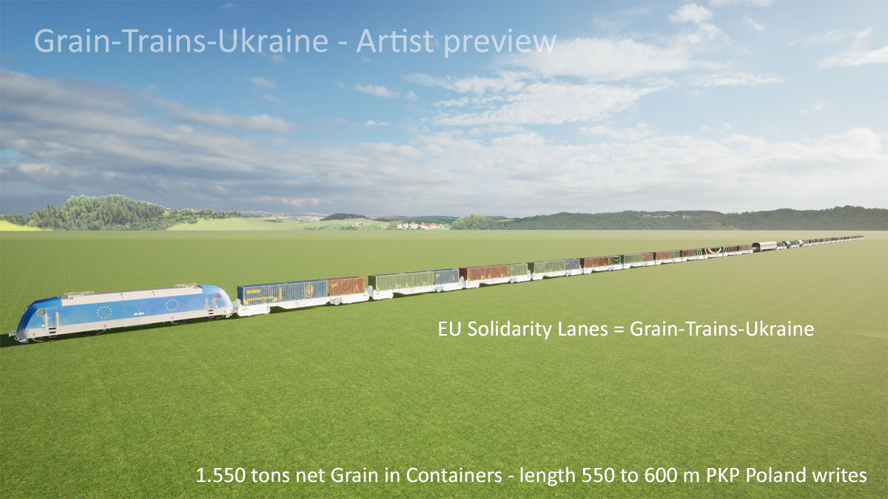

Slide 14
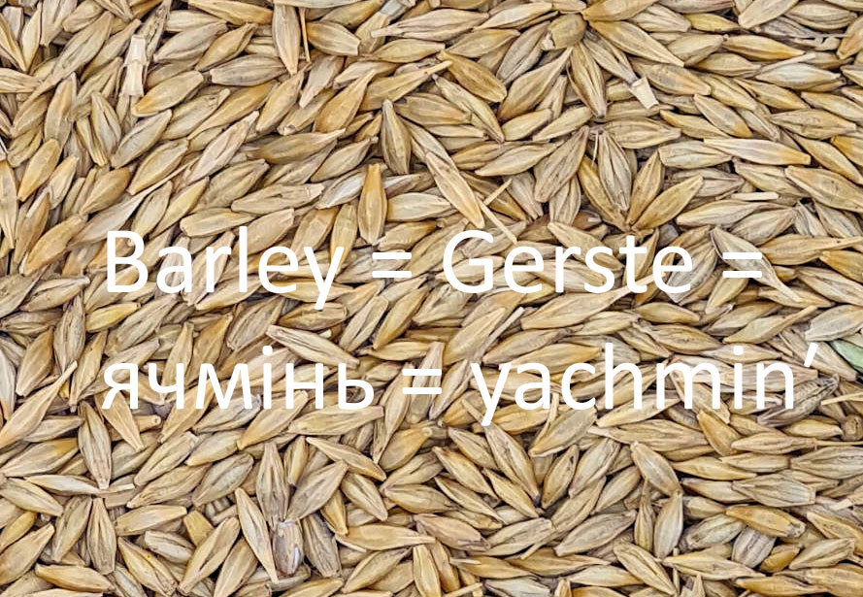
What does „Grain-Train-Ukraine“ offer to UA Farmers :
UA Farmers get as long as needed market-access to EU Harbours
UA farmers can deliver : Wheat, Rye, Corn, Barley and Sunflower Oil
UA farmers get : Diesel / Heizöl at affordable price from all Grain-Trains
UA coal power plants get cruched coal in waggons – uncruched in Containers
All prices are „political public table prices“ – that are slowly changed monthly
It seems to be possible to transport a complete UA 30 Mio. ton harvest / year

Slide 15
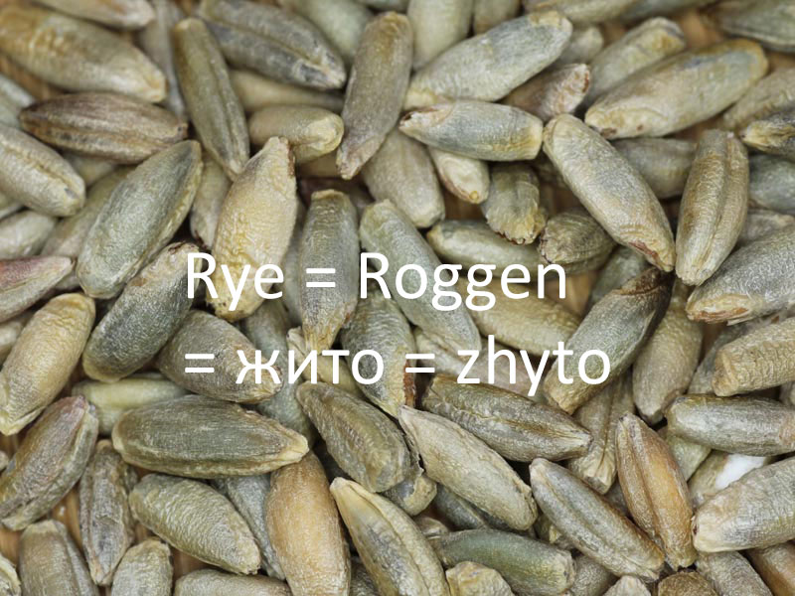
What is required to make Grain-Trains-Ukraine work well
FOLLOW THE PLAN – hello EU, hello DE, hello PL, hello EU countries – hello UA
EU CAB Valean buys Kongskilde Grain-Blower machines – supra-national-task
UA chamber of commerce, and Farmers and Agri-Companies ASK for „Grain-
Trains Ukraine – speak with UA Goverment – speak with EU and Germany and
the other involved EU countries
All Government owned Railway-Companies make a EUR / Container price
for the 4 – 6 lanes - that includes all fees and deloading-loading near border
Containers always stay on the waggons – no deloading –loading within EU

Slide 17
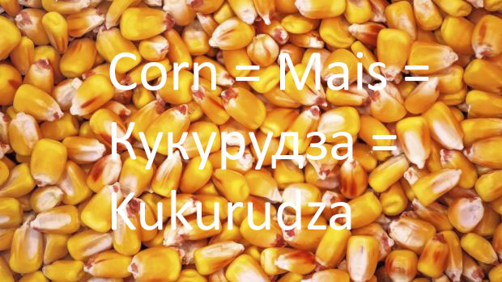
How to reach „Grain-Trains-Ukraine Plan Information“ Information is always live – use „search“ to find yours
Thanks for your attention to read / listen to the Plan
https://www.ing-goebel.de/grain-trains-rolling-01/
https://www.ing-goebel.de/grain-train-ukraine-pshenychnyy-poizd/
info@ing-goebel.com – Volker Goebel Ing. DE / Vitalii Gorunenko Ing. UA
We work closest with EU, BMDV, BMEL, BMZ, PKP, DB Cargo AG
and all participants of Grain-Market – we balance all interests …

Slide 18
Start-Financing / Investment to get Grain-Trains-Started :
we need to buy 4.000 Bulk Containers – collect in EU countries – foreign ministers
Germany BMDV talked about 23 Mio. € ! for „neue Behälter“ – „new containers“
Romania does good work - needs 40 Mio. € to overwork old existing 1.520 tracks
EU – please order and pay the Grain-Blowers – they have 2 month delivery time !!
G7 did a 4,5 Mio. EUR program for food security – we need 0,5 % from that – with
225 Mio. EUR on account, we can buy all it needs : Containers, Train-Capacities,
Deloding-Loading equipment, staff – and we can start BUYING Grain – we also
have to pay the Grain-Buyers and inspections in the Border-Area Poland/Ukraine
BUT – it will always be a fair market – we do build up private Grain-Trading and
pay back the Start-Investment – Grain-Trading and Transport is an Economy …

Slide 19
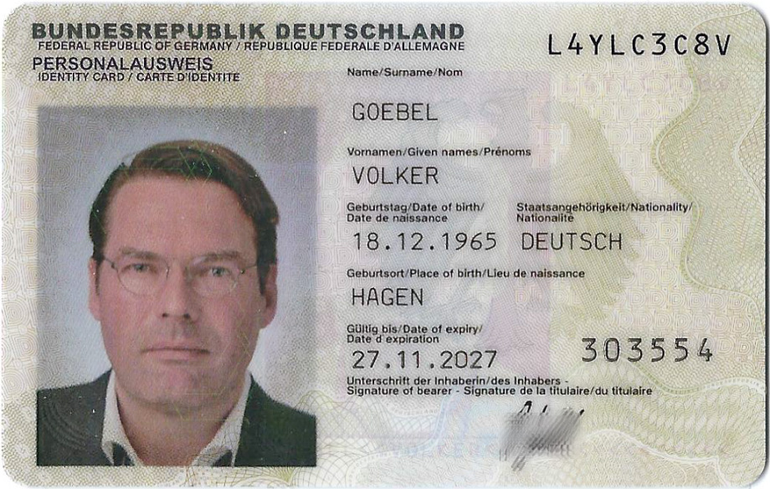
Have a nice day and be successful – do no loose hope …
Kanzler Scholz
Minister Özdemir
Ministerin Schulze
Ministerin Baerbock
BMDV Theurer MdB

Slide 20
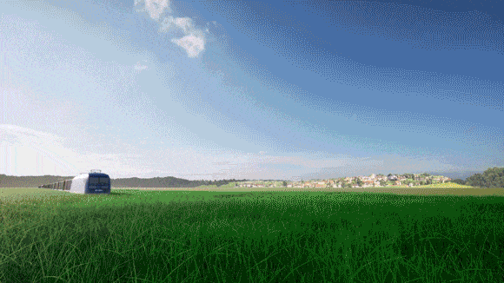
Grain-Train-Ukraine – see the train rolling - .gif

